Slide 1


UNIVERSITY OF THE ARMED FORCES-ESPE
FUNDAMENTALS OF ENGINEERING
2021-2022
UNIT 1 Software: enterprise resource planning

Slide 2
Team #1: DIGITAL TEAM
Apellidos y nombres 1 * Apellidos y nombres 2 Apellidos y nombres 3 Apellidos y nombres 4 NRC Grupo Nro. Nombre del profesor
Chiriboga Zurita Daniel Isai Kleber Enrique Chavez Oscullo Alcocer Marroquin Christian Daniel Roberto Alexander Bedon Guevara 7159 1 Lascano Jorge Edison

Slide 3


Software: Enterprise Resource Planning

Slide 4
What is the problem to solve?
-Companies need a system that allows us to collect in a single program the tasks of the entire company that have to do with productive and operational aspects
-Companies require tools that provide them with control and centralization of their information
- It also needs improvements in business processes and activities

Slide 5

Overview
We will develop a business management program with an intuitive search interface where we will find a complete database of our business where we will not waste time filling in documents payable and receivable, we will avoid problems with money transactions. all this information from customers, suppliers

Slide 6
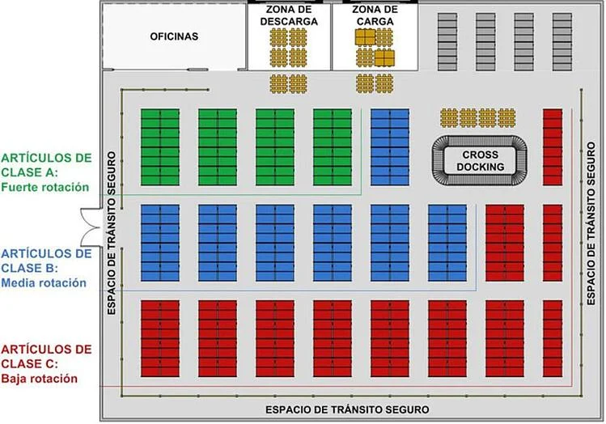
Background
The objective is to provide a quality and efficient service or product with a system that optimizes the company's processes for decision-making and better results.
The company can correctly manage the business inventory by controlling incoming and outgoing goods, organizing the warehouse, detecting low-turnover items, theft.
Get such as VAT, assets, liabilities, costs, expenses, taxes, general information about workers, customers and inventory.

Slide 7

Requirements
-The system should make it easier to view a company's accounts and tax returns
-The system should store classified information
-The system should allow a faster search for information about suppliers or customers that will be directly connected to the
program
-The system should sort and arrange for new goods to be received in the warehouse to be reflected in the system

Slide 8

Meeting

Slide 9

What is your role in this company?
I am in charge of managing the economic activities of the company, analyzing files, account statements, acquisitions, sales

Slide 10

What is the process you carry out to make a payment within your company?
A document is prepared specifying the concept of the data and the amount to be transferred, then that file is uploaded to the national interbank system in the file registration part then enter the central bank platform.

Slide 11
How complicated is it to keep these records and calculations?
It is complicated because all values ​​must be exact and I have to get the values ​​of all the areas for a general value

Slide 12
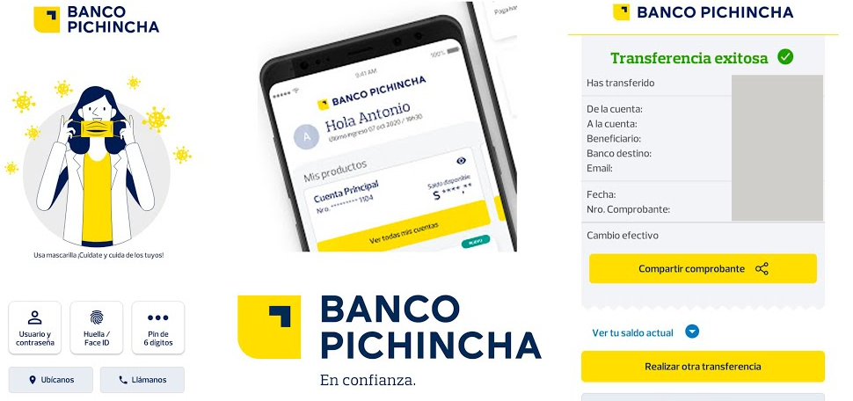
What types of financial reports have you prepared and how was the information used?
The information is transferred directly with the bank by means of digits contained in each bank, through which we can both receive and transfer a necessary information

Slide 13
Thanks !!! :)

